Slide 1
Lazy Beast
Project : Java Mini Project
Team Memebers : Jeet Undaviya[19DCE142]
3rd Sem B.Tech [CE]
Guide : Prof. Aishwariya Budhrani

Slide 2
Current scenario
In today's world everyone is moving towards the digital machine leaving behind traditional paper-pen. So computer knowledge is the basic necessity for today. And hence there have been Operating System is gradually improving there GUI (Graphical User Interface) and is make more and more user friendly.
But there is really very less evolution in CLI (Command Line Interface) and it have been pretty much the same over the years.

Slide 3
Hence it has not been that user friendly and users always find it very difficult when their OS is facing some issue and they have to use CLI.
Hence looking over to this issue I was motivated enough to solve this issue for Windows OS [ As many of the users are using it ].

Slide 4
Introduction
The project of the name is 'Lazy Beast' which explains pretty much everything from its name that it is the software which is designed for lazy users who don’t want to remember the commands of the CMD (Command Prompt) and can still do pretty much fire up the commands just by passing few shortcuts for the commands.

Slide 5
Features
Easy to remember shortcuts
Help and Usage for every shortcuts
Open and Close any programs from the same terminal.
Modify the console [Color ,Prompt ,Title] as per your requirement.
Run all the networking commands just by few shortcuts.
Get all the Logs for each commands.
Can directly generate archive in any format for any files or folder.
It can perform any of the System CMD operation right from the same terminal and can even open new system terminal window.
It can directly open Python console.
It can clear the console any time by typing its shortcut.

Slide 6
Software Requirements
Operating System :- Windows
Software :- 1. CMD(Command Prompt)
2. JRE (Java Runtime Environment)

Slide 7
Commands Shortcuts and its Usage

Slide 8
'0' OR 'back'
This command is used to come back to main Console.
Eg. back OR "0"

Slide 9
'1' OR 'clear' OR 'c'
This command is used to clear to any Console.
Eg. clear OR "1" OR "c"

Slide 10
'2' OR 'open'
This command is used to open program.
NOTE :- Program will open in new window. And "open -m" will display menu for opening programs with shortcuts.
Eg. open notpad xyz.txt OR o 1 OR "2 notepad.exe"

Slide 11
'3' OR 'close'
This command is used to exit from any Console or to close any on-going console or program.
NOTE:- Typing 'close -all' will open all programs running similar process.
Eg. close PyCmd OR close OR "3" OR "3 SysCmd"

Slide 12
'4' OR 'help'
This command is used to have excess to Help Console.
Eg. help OR "4" OR "h"

Slide 13
'5' OR 'modify'
This command is used to modify the colour, title and prompt Console.
NOTE:- Typing 'modify off' all modification will be disabled and it will do the the default colour, title and prompt.
Eg.modify colour OR "5 title"

Slide 14
'6' OR 'syscmd'
This command is used to have excess to System Console or to run any sys commands.
NOTE:- Typing 'SysCmd -n' will open SysCmd program in a new window.
Eg. syscmd OR
syscmd ping www.google.com OR "6"

Slide 15
'7' OR 'pycmd'
This command is used to have excess to Python Console.
NOTE:- Program will open in new window.
Eg. pycmd OR "7"

Slide 16
'8' OR 'archive' OR
'arc'
This command is used to make archive of files and folders in different fromat like 7z,zip,rar,etc.
NOTE:- Only typing 'archive' will open 7z File-Manager program in a new window.
Eg. arc <extension> <output loc> <input loc> OR "8"

Slide 17
'9' OR 'sysnet' OR
'net'
This command is used to execute networking commands and display in console.
NOTE:- Program will open in new window. And "sysnet -m" will display menu for opening program with shortcuts.
Eg. sysnet -m OR "9 <Sub command>"

Slide 18
Screenshots

Slide 19
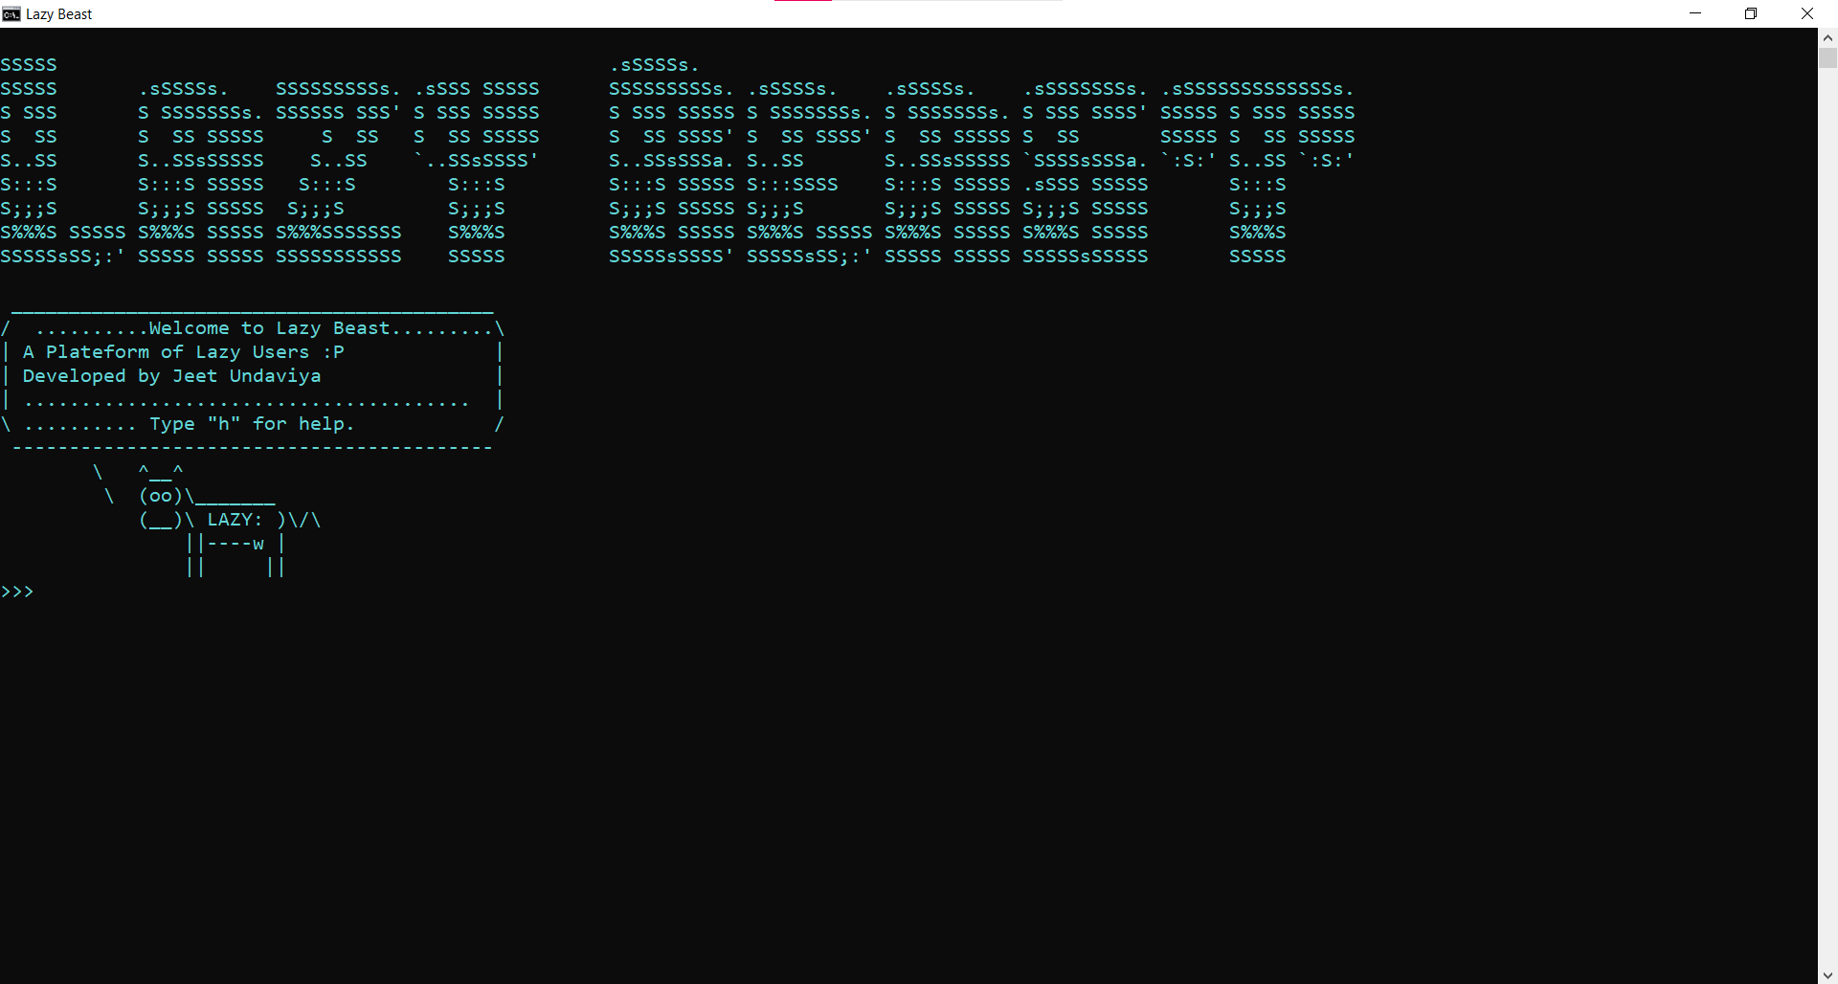
Welcome Screen

Slide 20
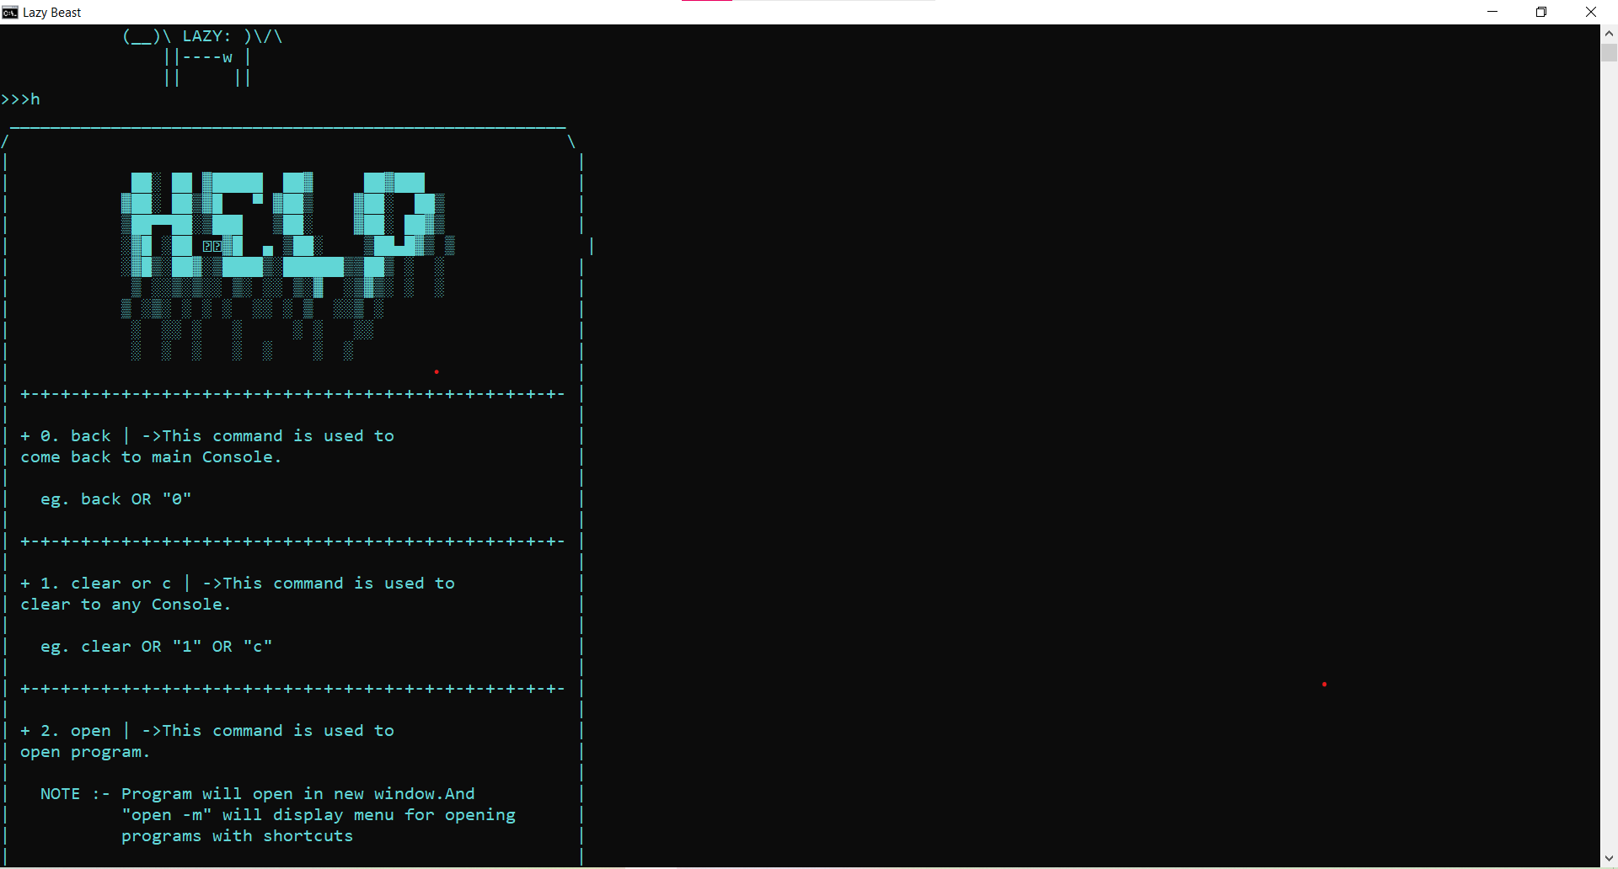
Help

Slide 21
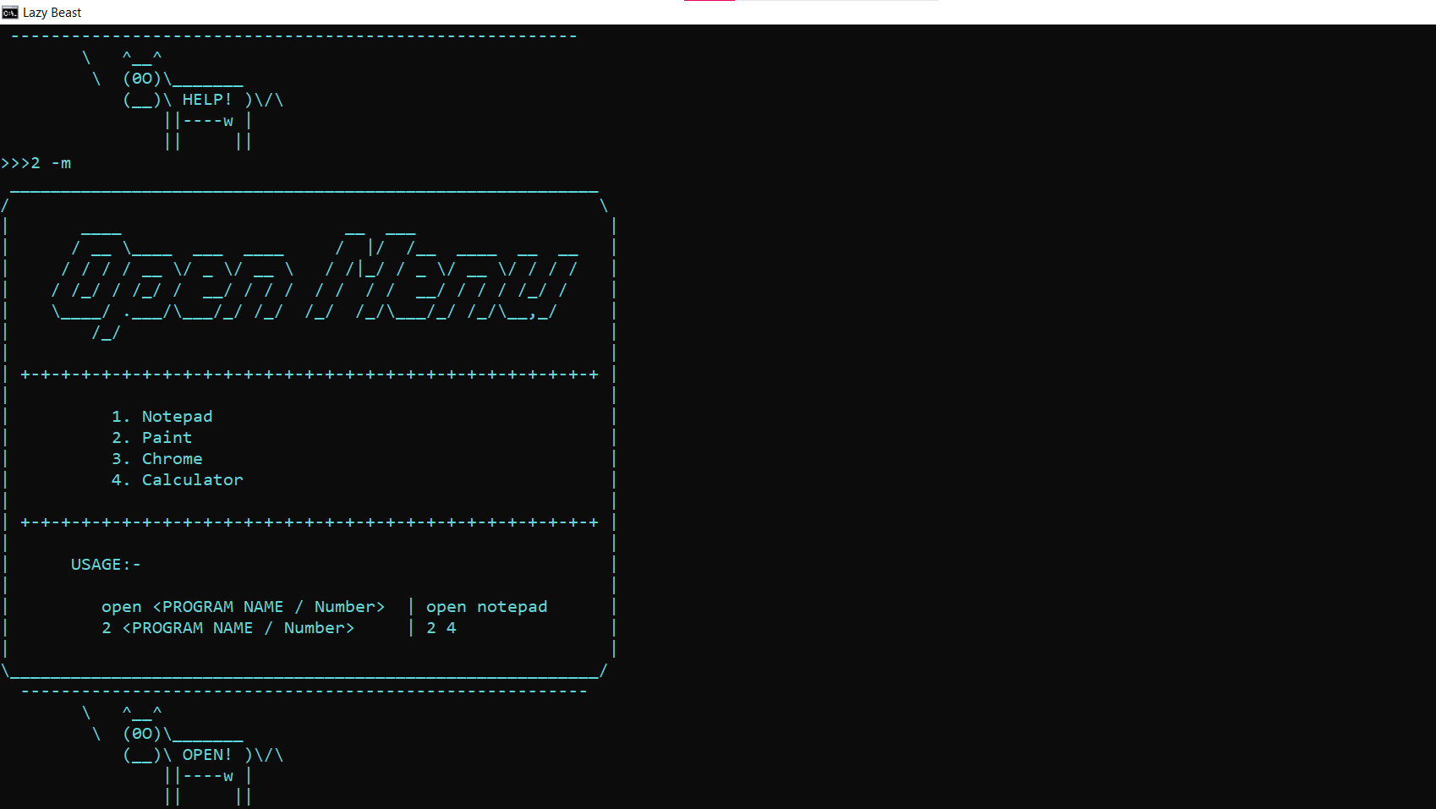
Open menu

Slide 22
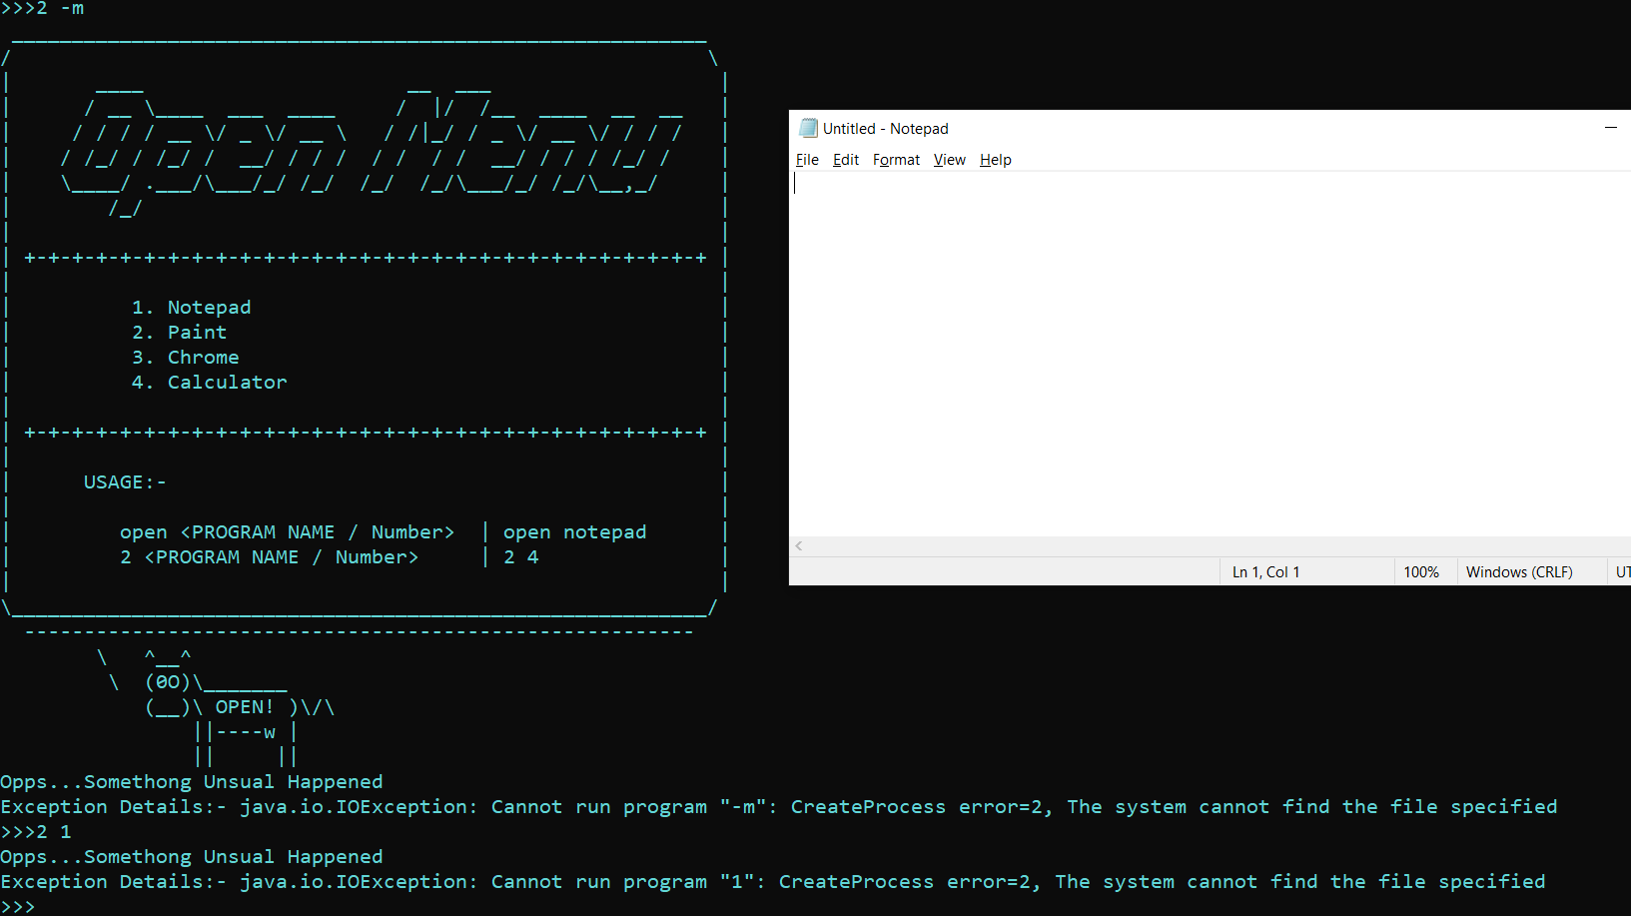
Opening Notepad

Slide 23
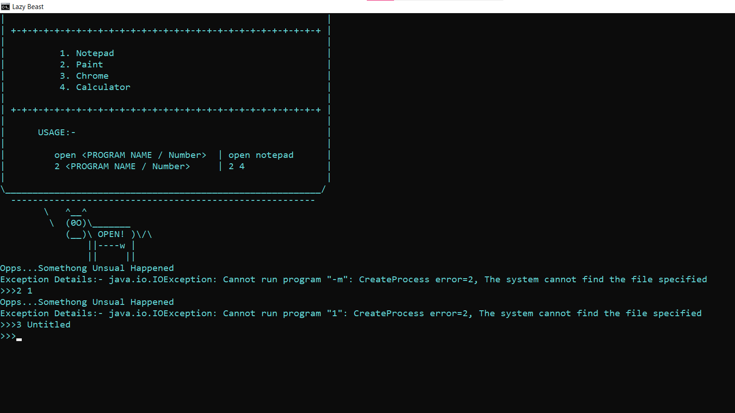
Closing Untitled Notepad

Slide 24
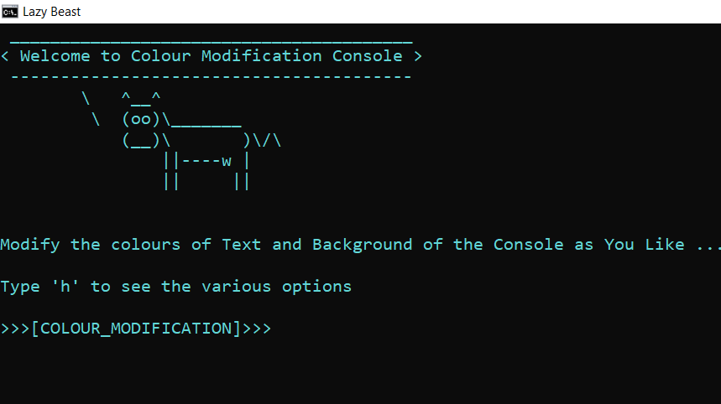
Modifying colour console

Slide 25
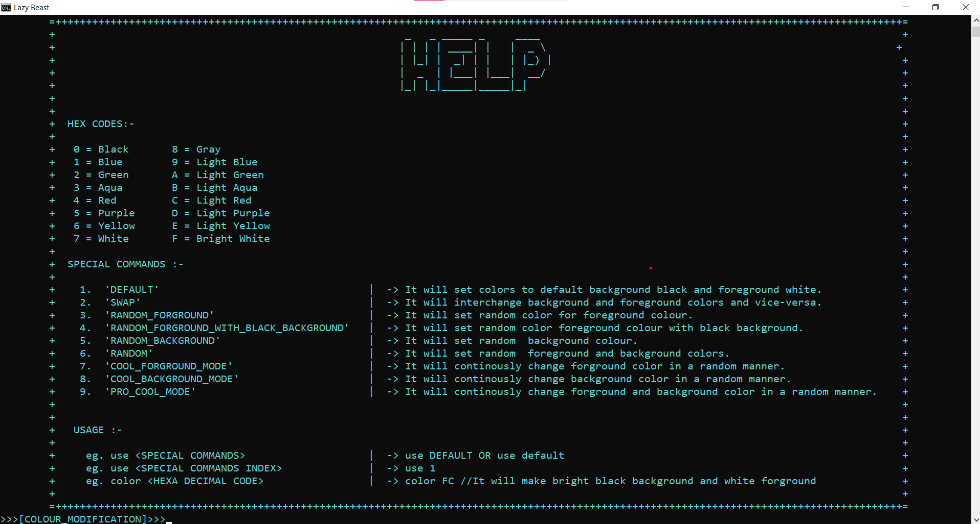
Help in colour modification console

Slide 26
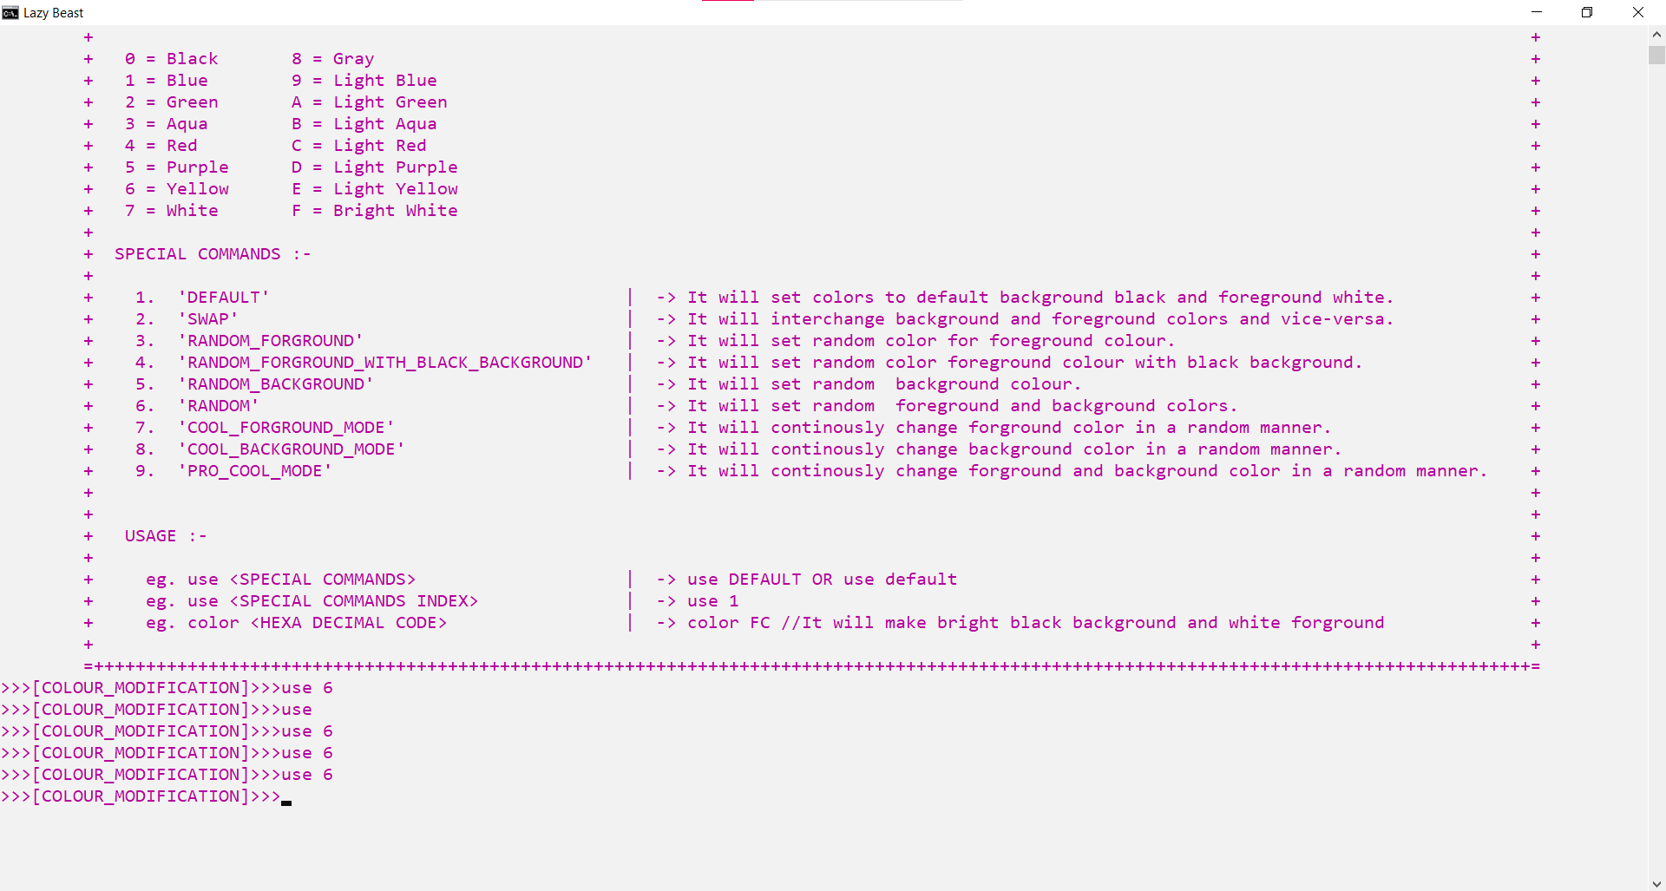
Modifying colours

Slide 27
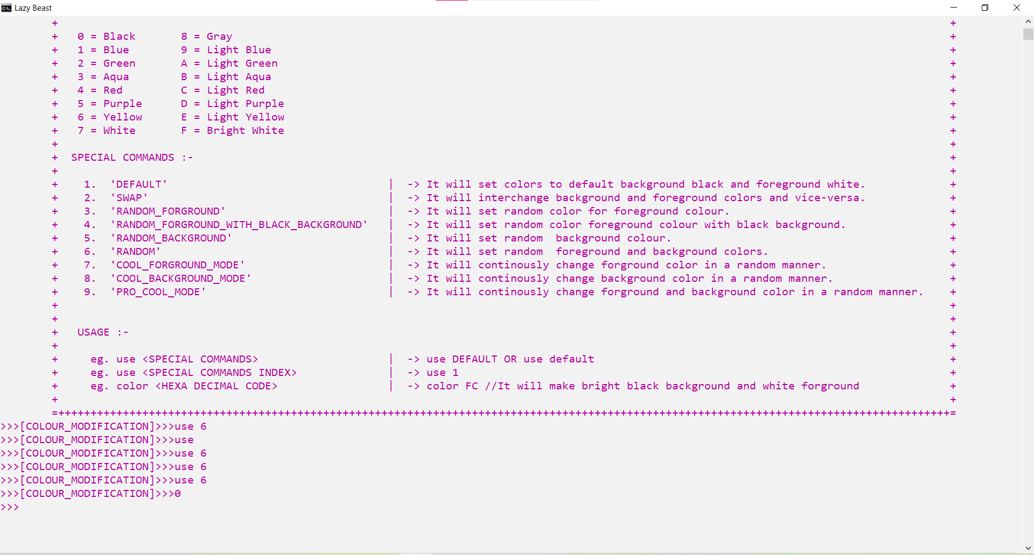
Back to main console

Slide 28
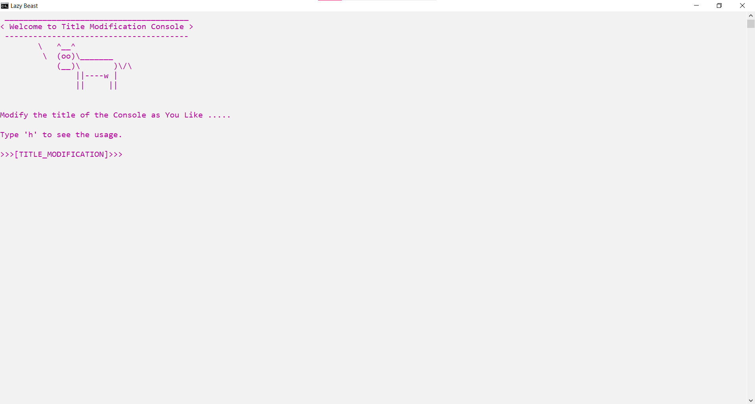
Modifying title console

Slide 29
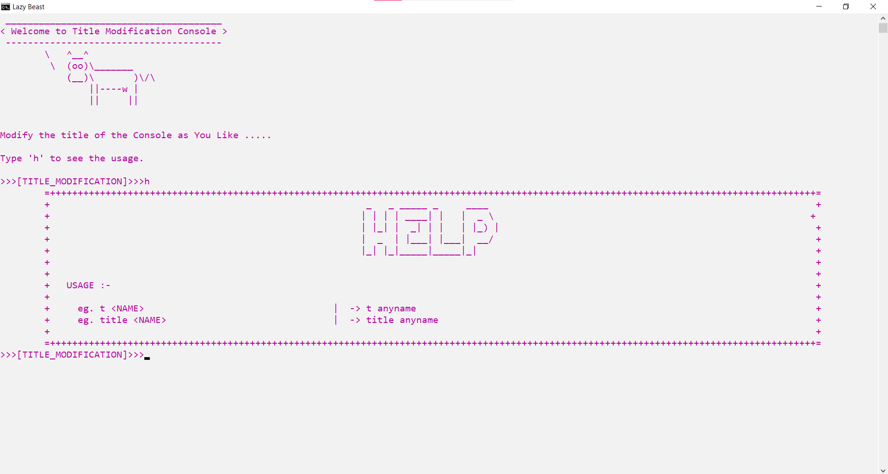
Help in Modifying title console

Slide 30
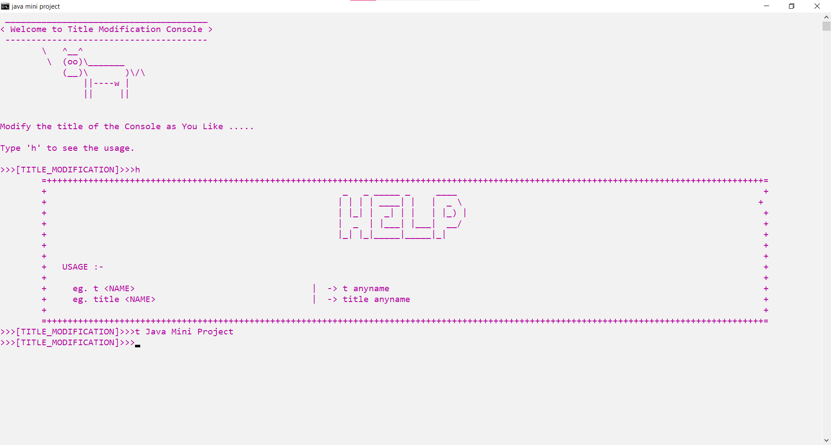
Modifying title

Slide 31
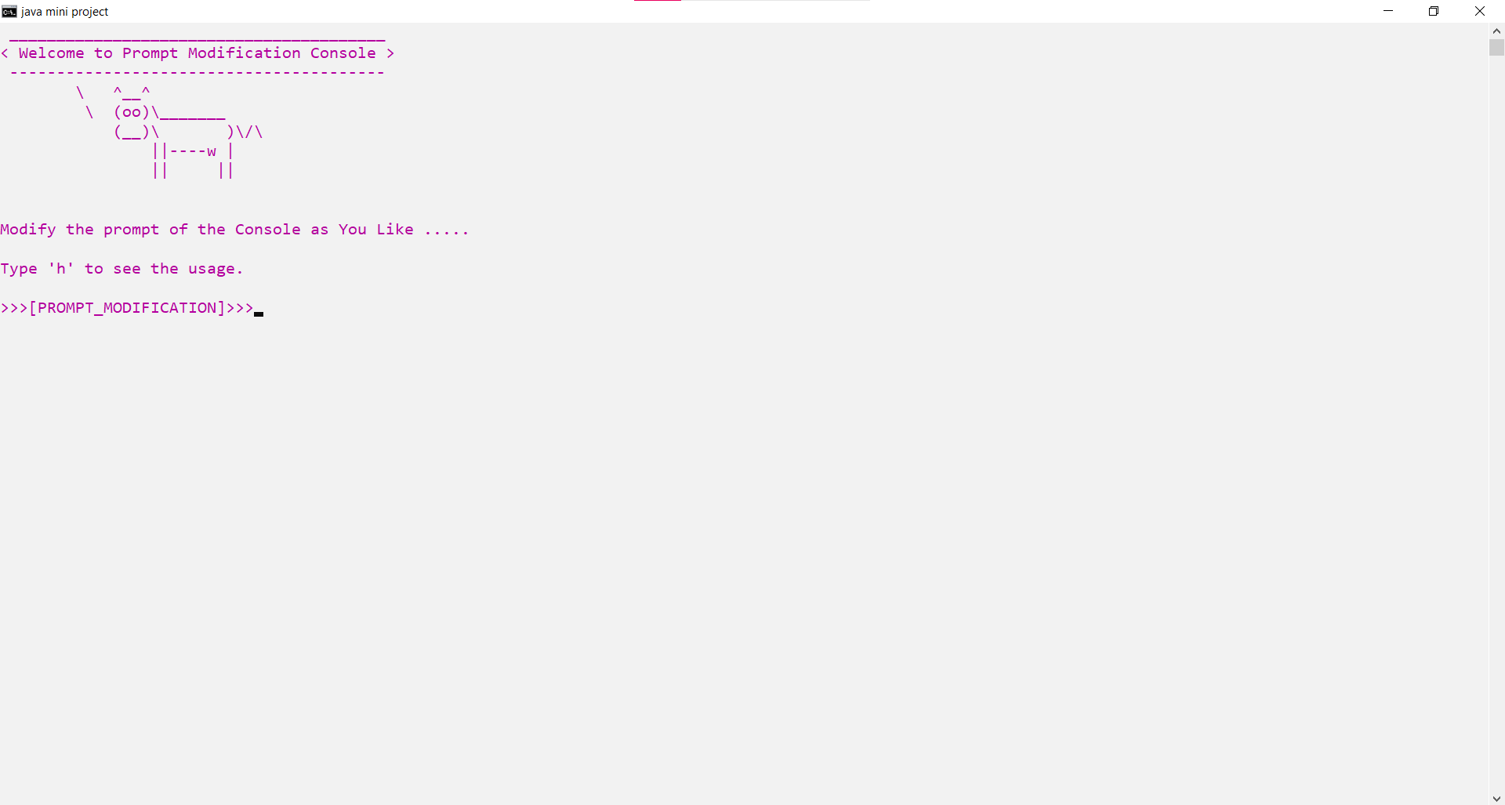
Modifying prompt console

Slide 32
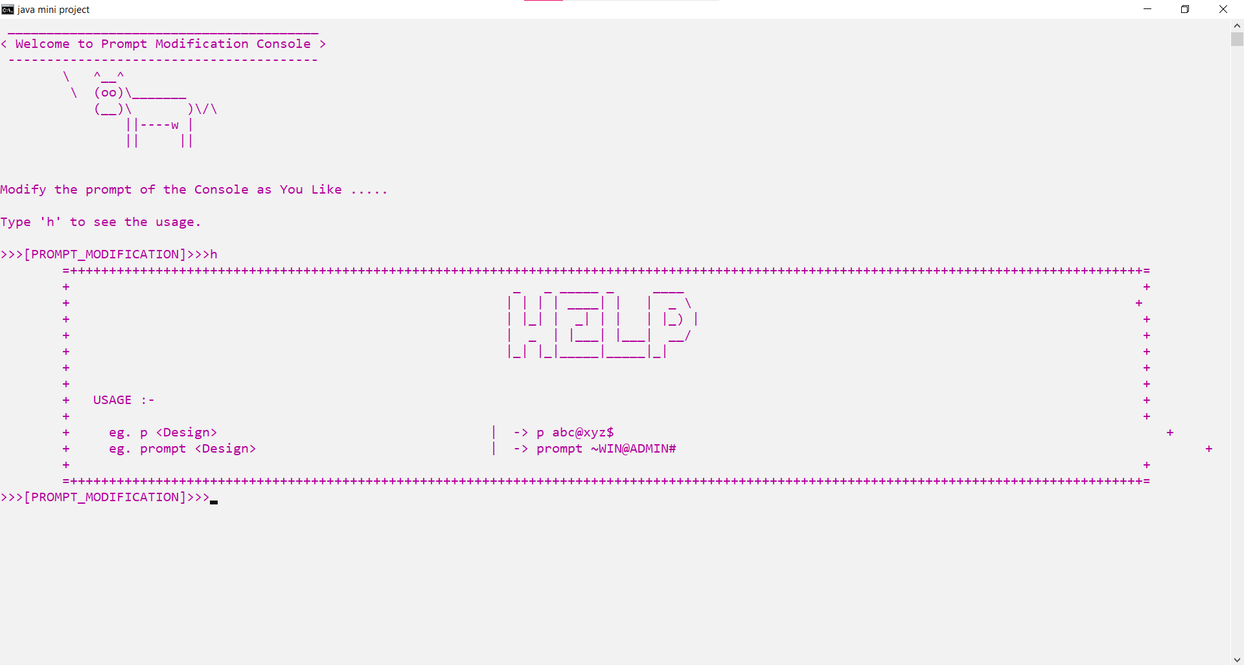
Help in Modifying prompt console

Slide 33
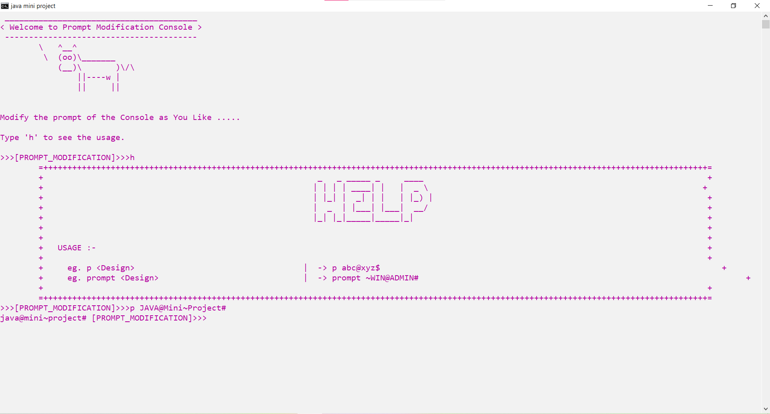
Modifying prompt

Slide 34
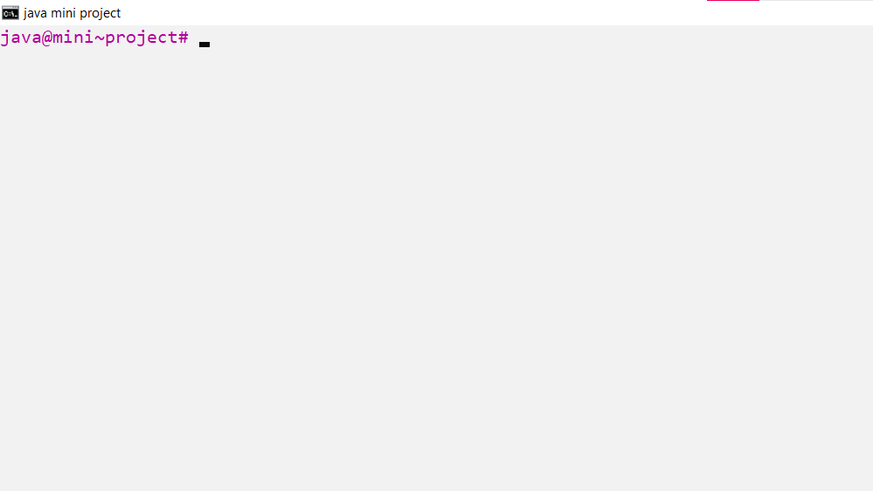
Cleared up the main console

Slide 35
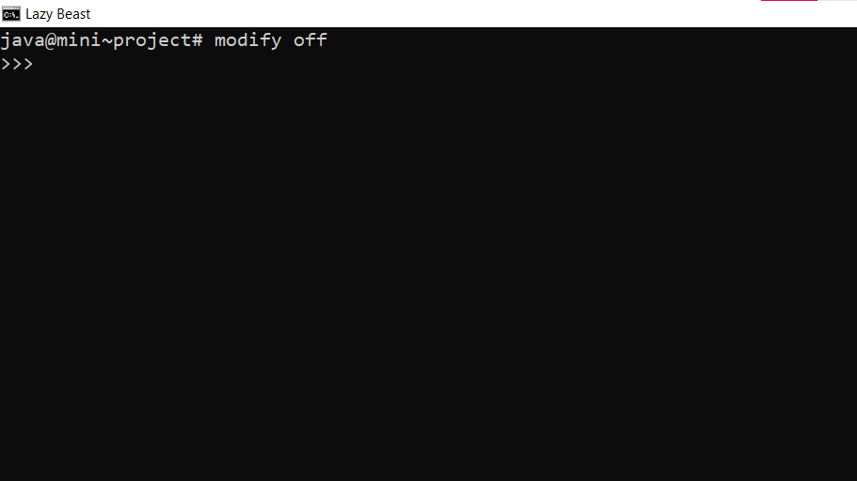
Disabling modification and switching back to defaults

Slide 36
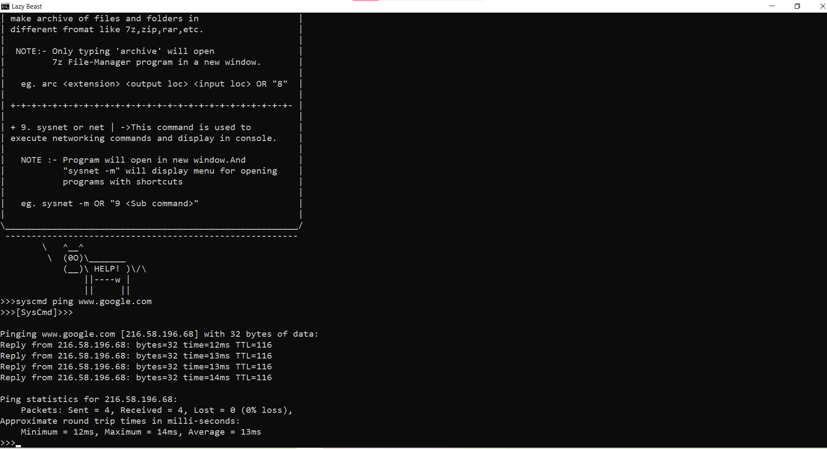
Executing commands in syscmd and retuning back in main console

Slide 37
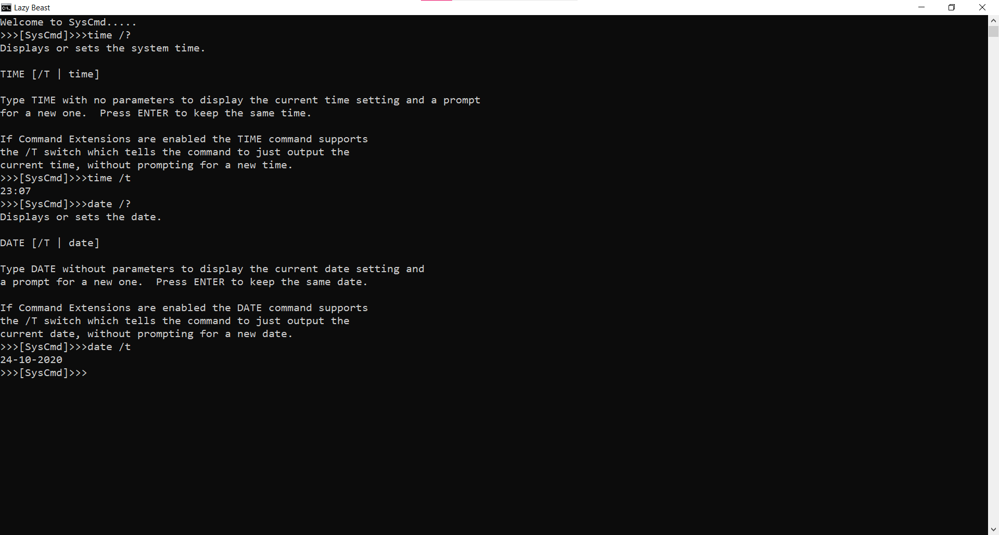
Entering in syscmd in same terminal and executing system commands

Slide 38
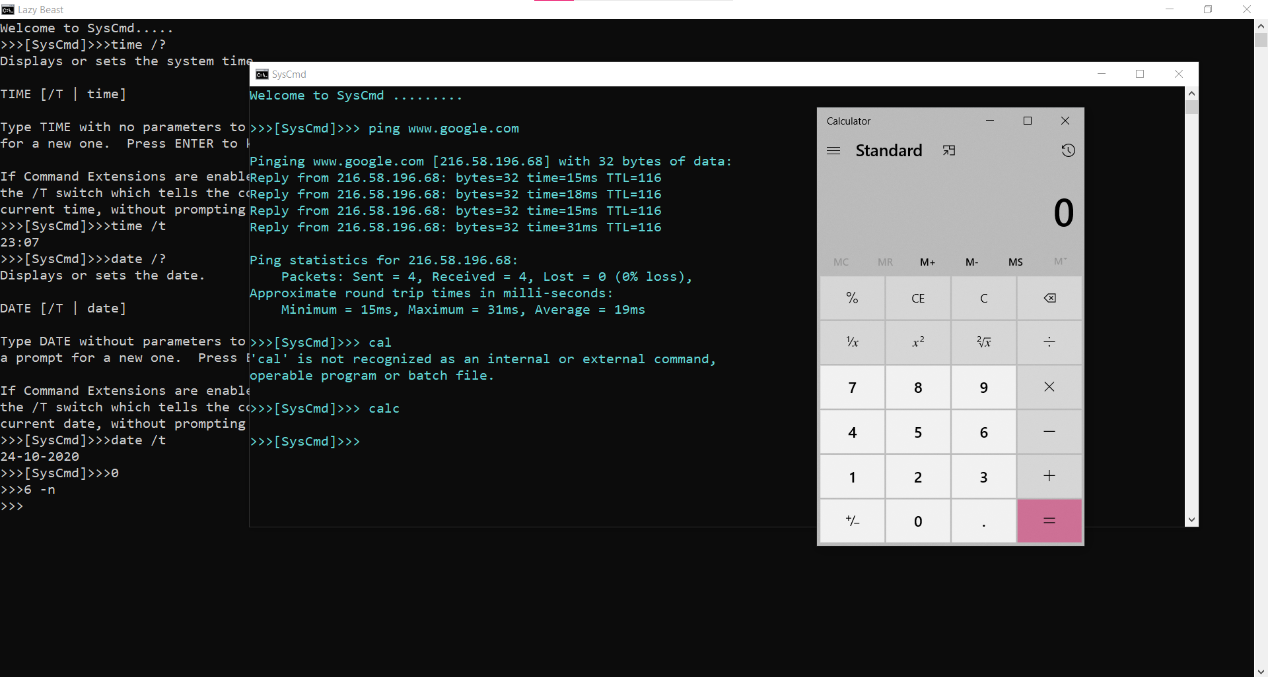
Opening syscmd in new window

Slide 39
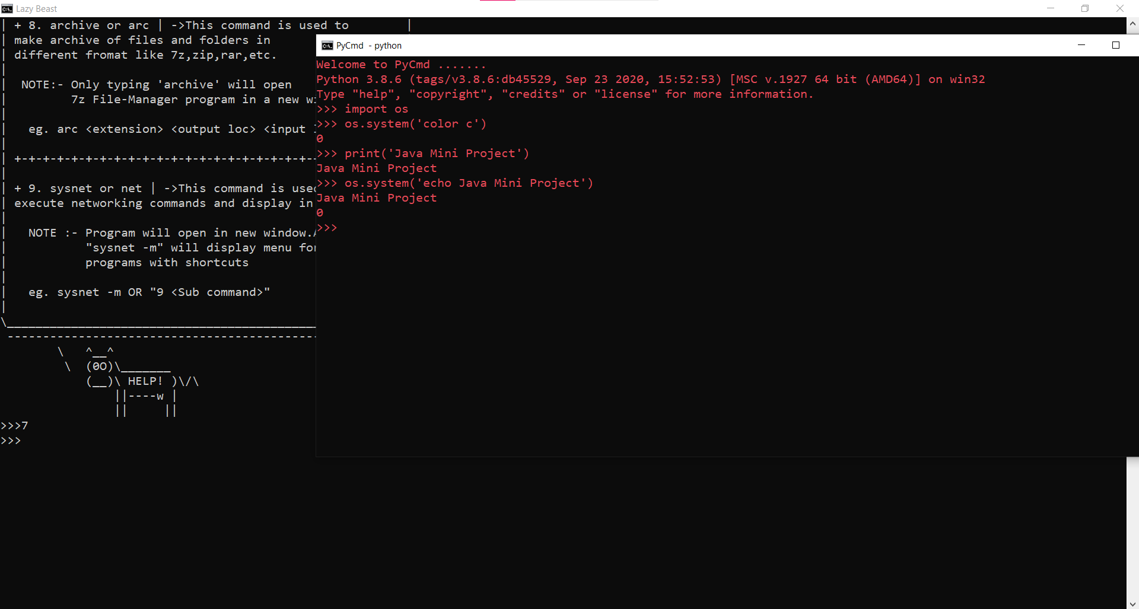
Opening Pycmd

Slide 40
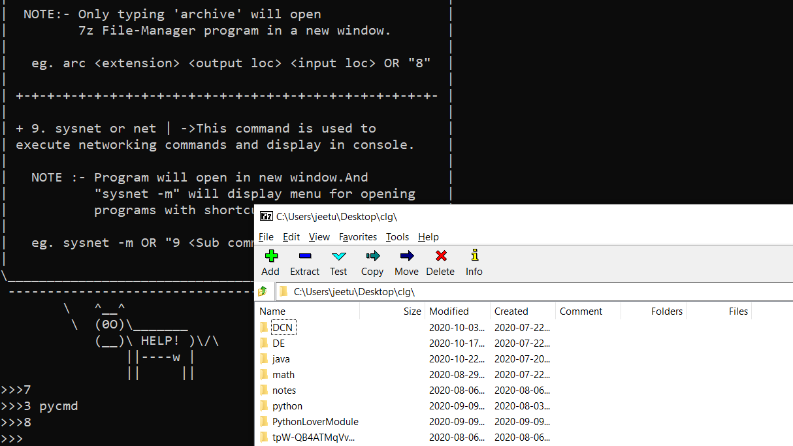
Opening 7z manager for archive

Slide 41
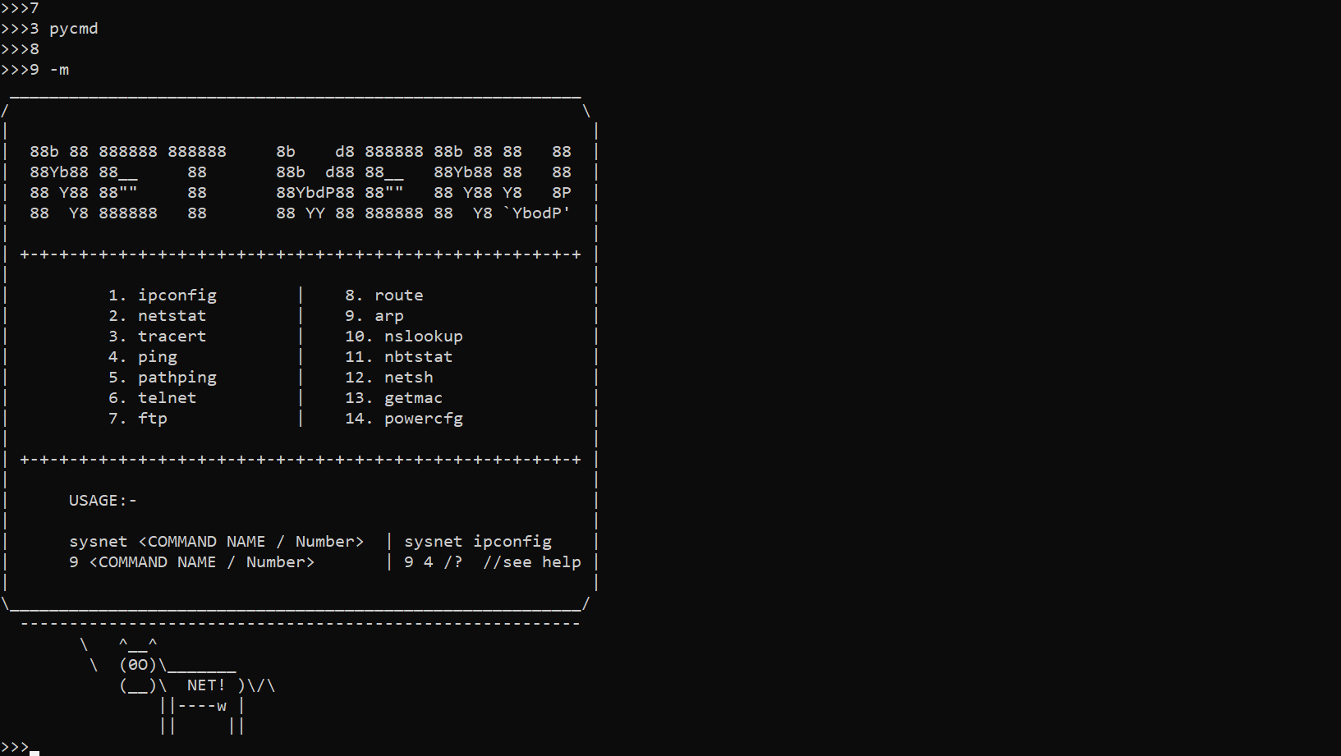
Opening sysnet menu

Slide 42
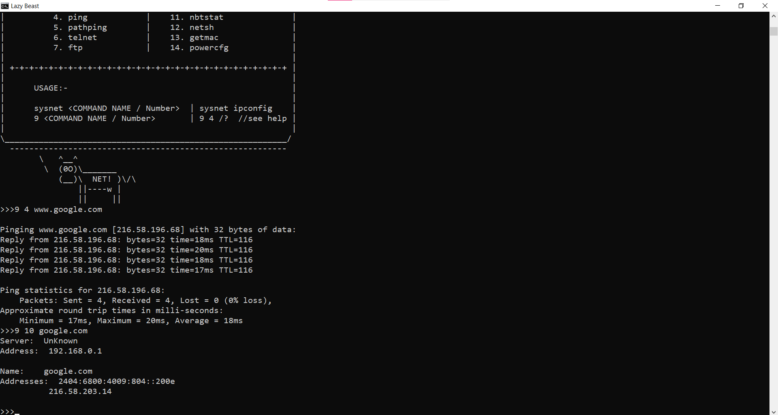
Executing sysnet commands

Slide 43
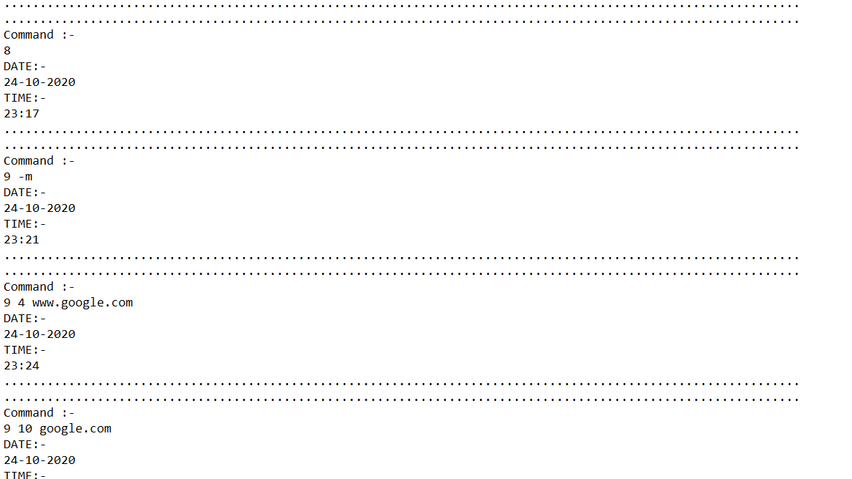
Logs For each and every command created

Slide 44
Who should care about it !!
This is totally modifiable terminal which can pretty much perform any of the system operation you want hence we can make use it for some of specific purpose when we have restrict want some of the restriction on some of the commands and hence we can do the same and use it for the specific purpose only.
Secondly as there are many of the shortcuts hence any of the normal user can just fire up the command like a piece of a cake without remembering any of it.

Slide 45
Future enhancements
I made this project just for the CMD (Command Prompt). But it could be also developed for the Powershell , Linux terminal or for Termux (android mobile Linux terminal).
And also the addition of the features in it is always limitless. Hence there can always be scope of improvement in it.

Slide 46
Origin of the idea
There exist such script for the Linux environment called 'Lazy Script' which is developed for performing penetration testing and hacking in an easier way.
But it is strictly platform dependent [Linux]
The GitHub link for this project is as below :-
https://github.com/arismelachroinos/lscript
Hence if you want to try something like it for Windows then you can try my project.
GitHub link for my project [Lazy Beast] is as below :-
https://github.com/jeetundaviya/Lazy-Beast

Slide 47
REFERENCES
[1]https://github.com/arismelachroinos/lscript
[2]https://docs.oracle.com/en/java/
[3]https://docs.oracle.com/en/java/
[4]https://www.geeksforgeeks.org/java-program-open-command-prompt-insert-commands/
[5]https://patorjk.com/software/taag/

Slide 48
Thank You
Be Lazy and use Lazy Beast :p

